Slide 2

Get Started With Bots, Chat and Fully Integrated Omnichannel in Dynamics 365
DE05, 12 March 2019, 8:00AM – 9:30AM, Champions Room

Slide 3


Quick Intro
Todd Lewis
Director, Technical Solution Sales
CafeX Communications
tlewis@cafex.com
https://www.linkedin.com/in/1toddlewis/

Slide 4
Session Agenda
Omnichannel: what and why
Walk through Live Assist
Build your own bot with transition to live chat
Embedding video conferencing with ease
Wrap-up with Q & A

Slide 5
Omnichannel: What & Why

Slide 6
By 2020, Customer Experience will overtake price and product as the key brand differentiator.
- Walker Study

Slide 7
6 factors when considering omnichannel
Channels & personalized experiences
360 degree customer view
Mobile
integration
BOT integration
Agent productivity
Content engagement

Slide 8

Live Assist for Microsoft Dynamics 365 Overview

Slide 9

Microsoft’s Preferred Omnichannel Provider
Cobrowse
Voice
Single stack omnichannel offering
Co-engineered with Microsoft
Mobile & web engagement
Committed joint roadmap
Single pane of glass for agents
Content Campaigns
Bot Integration
Live Chat
Video

Slide 10
Single Stack Offering for all current and future omnichannel needs across mobile and desktop - chat, co-browse, voice, video, chatbot
Committed Joint Roadmap across Dynamics 365 releases
Immersive Experience across customer and user experiences
Only Omnichannel Solution Co-Developed with Microsoft
Live Chat
Co-Browse
Bot
Voice
Video
Right Within
Dynamics 365 Customer & User Experience

Slide 11

Extending the Power of Dynamics 365
Reduce customer effort and personalize engagement with chat to voice/video escalation
Resolve problems faster at lower cost with co-browse only
Accelerate Sales with omnichannel for D365 Sales Workload
Automate customer engagement and improve agent efficiency via new bot integration capabilities
Customize offers and increase sales using transcript API
Meet compliance and security with PCI Data Masking
Deeper Integration with Dynamics 365 Automates Customer Engagement, Accelerates Sales and Reduces Customer Effort

Slide 12
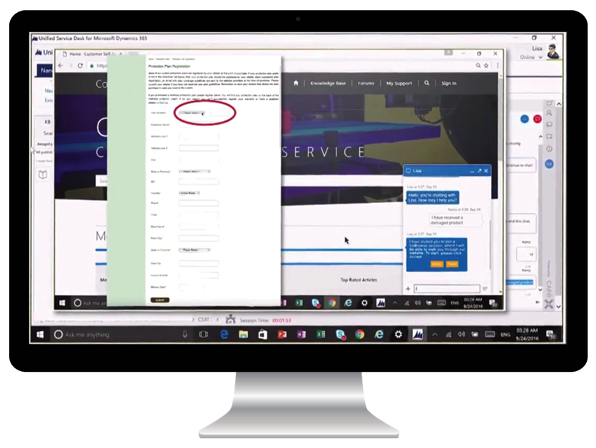
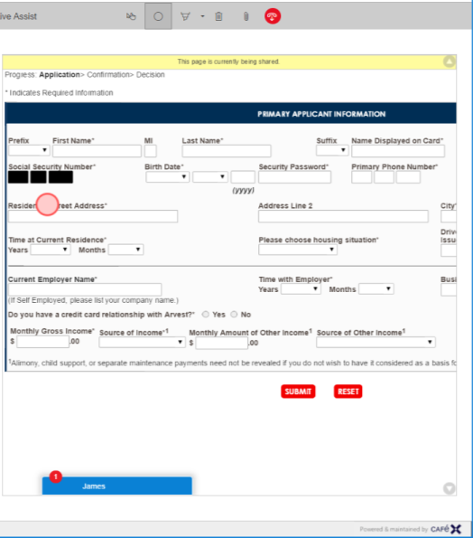
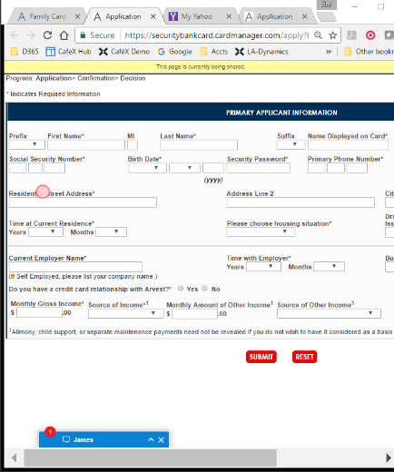

Consistent Cobrowse Experience Across Platforms
Agent and visitor share the same view of iOS, Android apps or web page
Sensitive information can be masked from agent view
Agents can push files, fill out forms remotely and annotate
Can accompany PSTN call or web chat
Agent view
Customer view

Slide 13
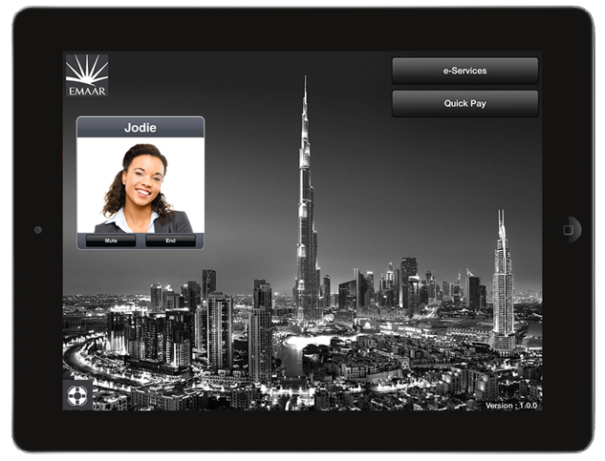
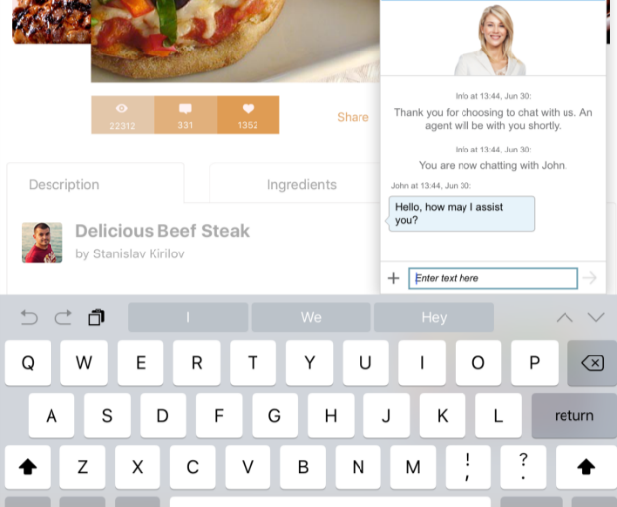
Mobile Experience – Consistent Experience Anywhere, Anytime
Available across native apps AND mobile browsers
Native integration with Mobile SDK:
Integrated in hours
iOS 9 and above
Android 5.1 and above
Seamless transition between cellular and wifi
Same portal used to configure both desktop and mobile campaigns
Mobile browser support:
Android (Chrome) & iOS (Safari) web applications with tags deployed as normal.
Supports responsive and progressive websites

Slide 14
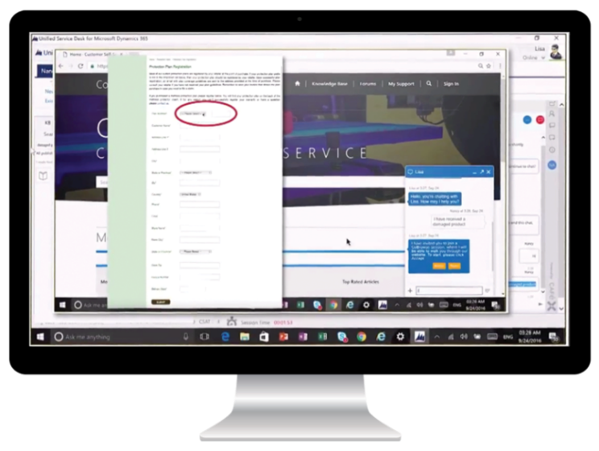
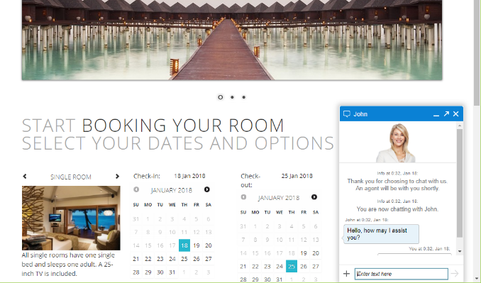

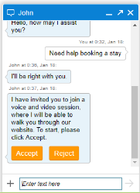
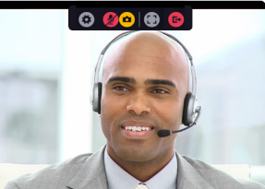
Escalate from Chat to Voice/Video: How It Works
Escalate Chat Engagement to Voice & Video Interaction for Faster Resolution and Personalized Experience
Chat, talk face-to-face, co-browse and share content simultaneously
No new plugins or downloads for visitors
Embedded call window for agents in Dynamics 365

Slide 15



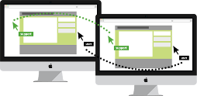
Deployment Model 1:
Bot as an Agent
Live Assist for Dynamics 365 engagement rules define when Bot is offered to customer
Bot uses the Live Assist for Dynamics 365 User Interface
Bot is managed as an Agent in Live Assist for Dynamics 365
Chats are routed to the bot by skill
Bots can transfer to and receive transferred chats from other agents
Supervisors can monitor the bot and intercede where necessary
Chat Activities are created in Dynamics 365 for the whole interaction
Start with Bot as a Task Based Assistant
2) Transfer to Agent
1) Route to Bot
3) Continue Chat

Slide 16
Good First Step to Leverage Bots: Introduce Bot as a Task Based Assistant
Human Agent is engaged with customer via Chat
Agent needs a task to be completed that will take some time. i.e. collect customer information
Agent can transfer chat to a bot to fulfil task, freeing up the human agent for other more complex work
Once bot has completed task, chat is transferred back to Human Agent to continue chat conversation.
2) Complete Task
1) Transfer
3) Transfer
4) Continue Chat

Slide 17
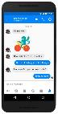







Deployment Model 2:
Bot as an Enabler
Bot exists outside of Live Assist for Dynamics 365 and has to define when Chat is offered to customer
Bot uses own User Interface (e.g. Custom, Facebook Messenger, Skype...)
Bot enables customer to communicate over different channels with Live Assist for Dynamics 365 Agents
Bot remains in the path for the whole conversation with the agents
Supervisors cannot monitor the bot in Live Assist for Dynamics 365
Chat Activities are created in Dynamics 365 only for the escalated interaction
Live Assist for Dynamics 365 Libraries

Slide 18
Walk through Live Assist

Slide 19
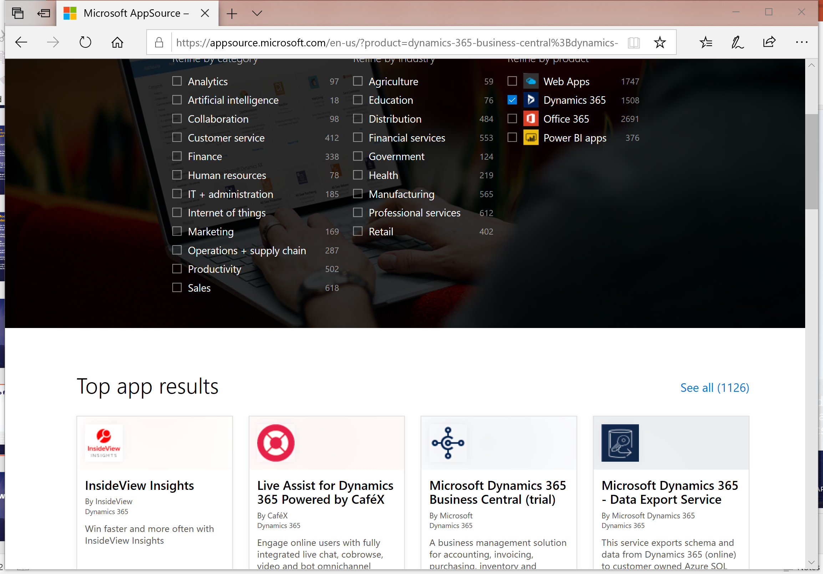
Where to find Live Assist
Chat, talk face-to-face, co-browse and share content simultaneously
No new plugins or downloads for visitors
Embedded call window for agents in Dynamics 365

Slide 20
How to Build Your Own Bot

Slide 21
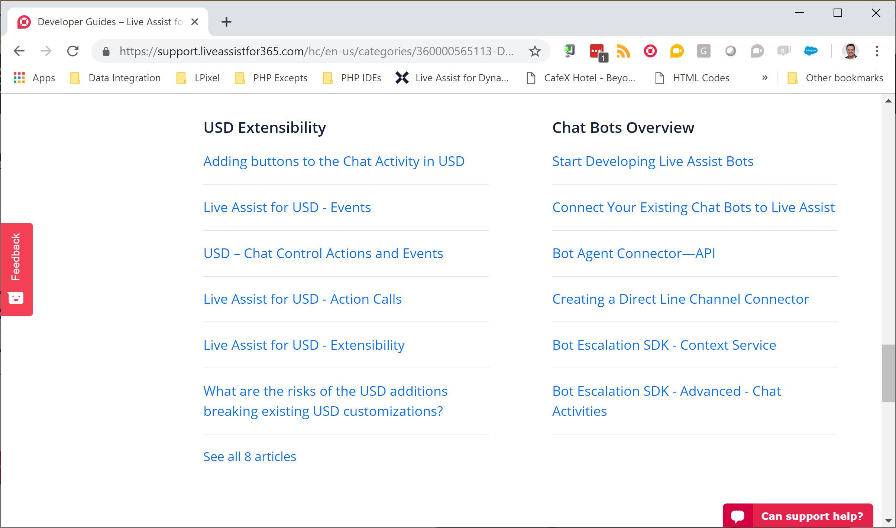
Follow our guides!
Chat, talk face-to-face, co-browse and share content simultaneously
No new plugins or downloads for visitors
Embedded call window for agents in Dynamics 365

Slide 22
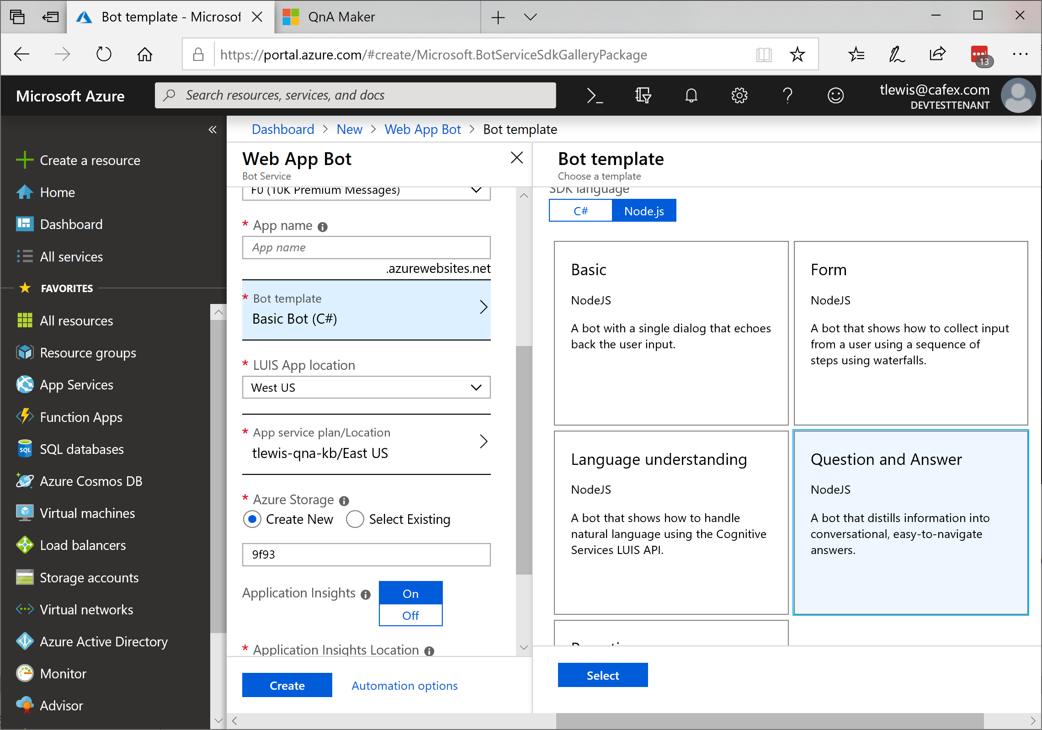
Web App Bot on Azure
Chat, talk face-to-face, co-browse and share content simultaneously
No new plugins or downloads for visitors
Embedded call window for agents in Dynamics 365

Slide 23
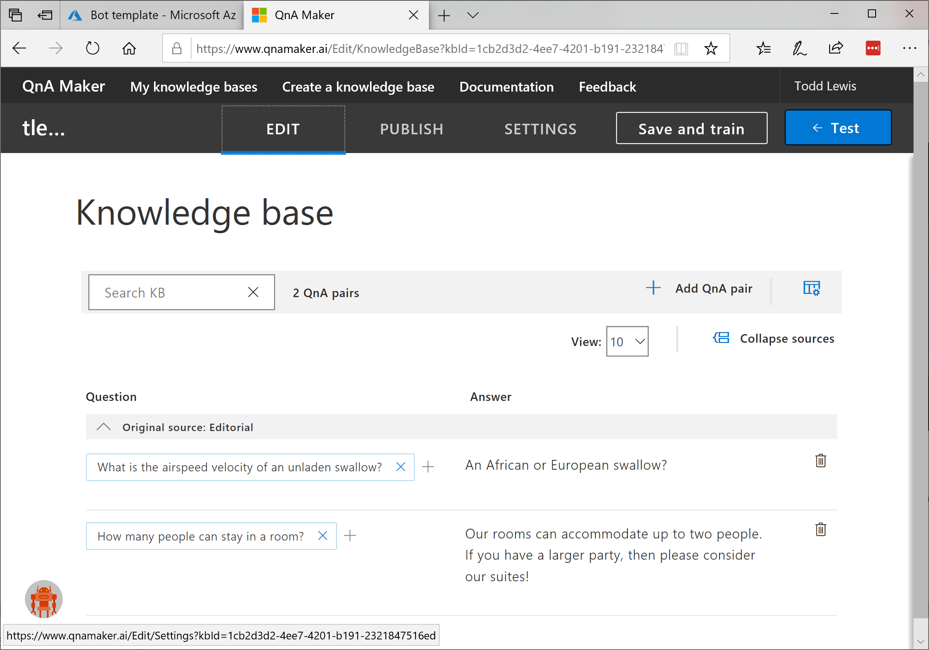
QnA Maker (qnamaker.ai)
Chat, talk face-to-face, co-browse and share content simultaneously
No new plugins or downloads for visitors
Embedded call window for agents in Dynamics 365

Slide 24
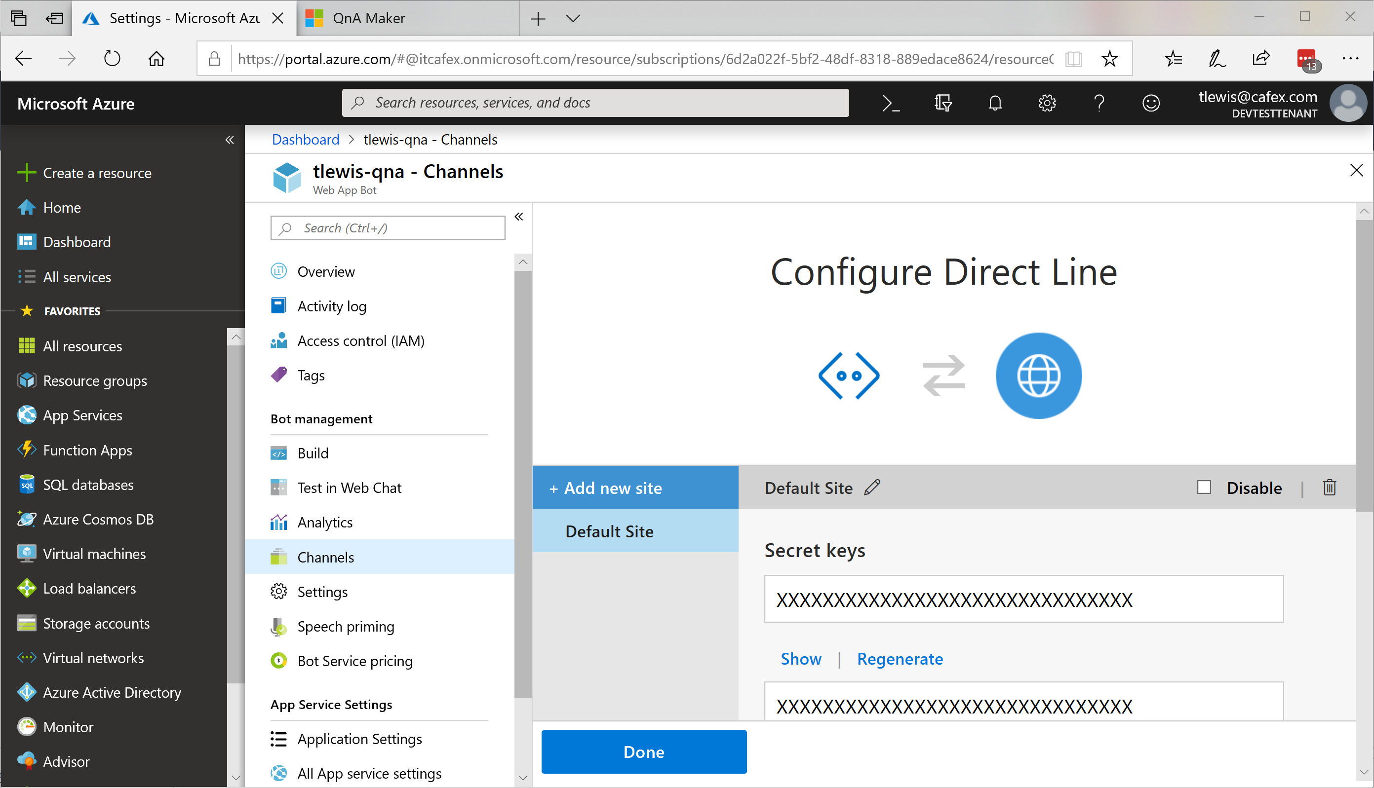
Get Direct Line Key
Chat, talk face-to-face, co-browse and share content simultaneously
No new plugins or downloads for visitors
Embedded call window for agents in Dynamics 365

Slide 25
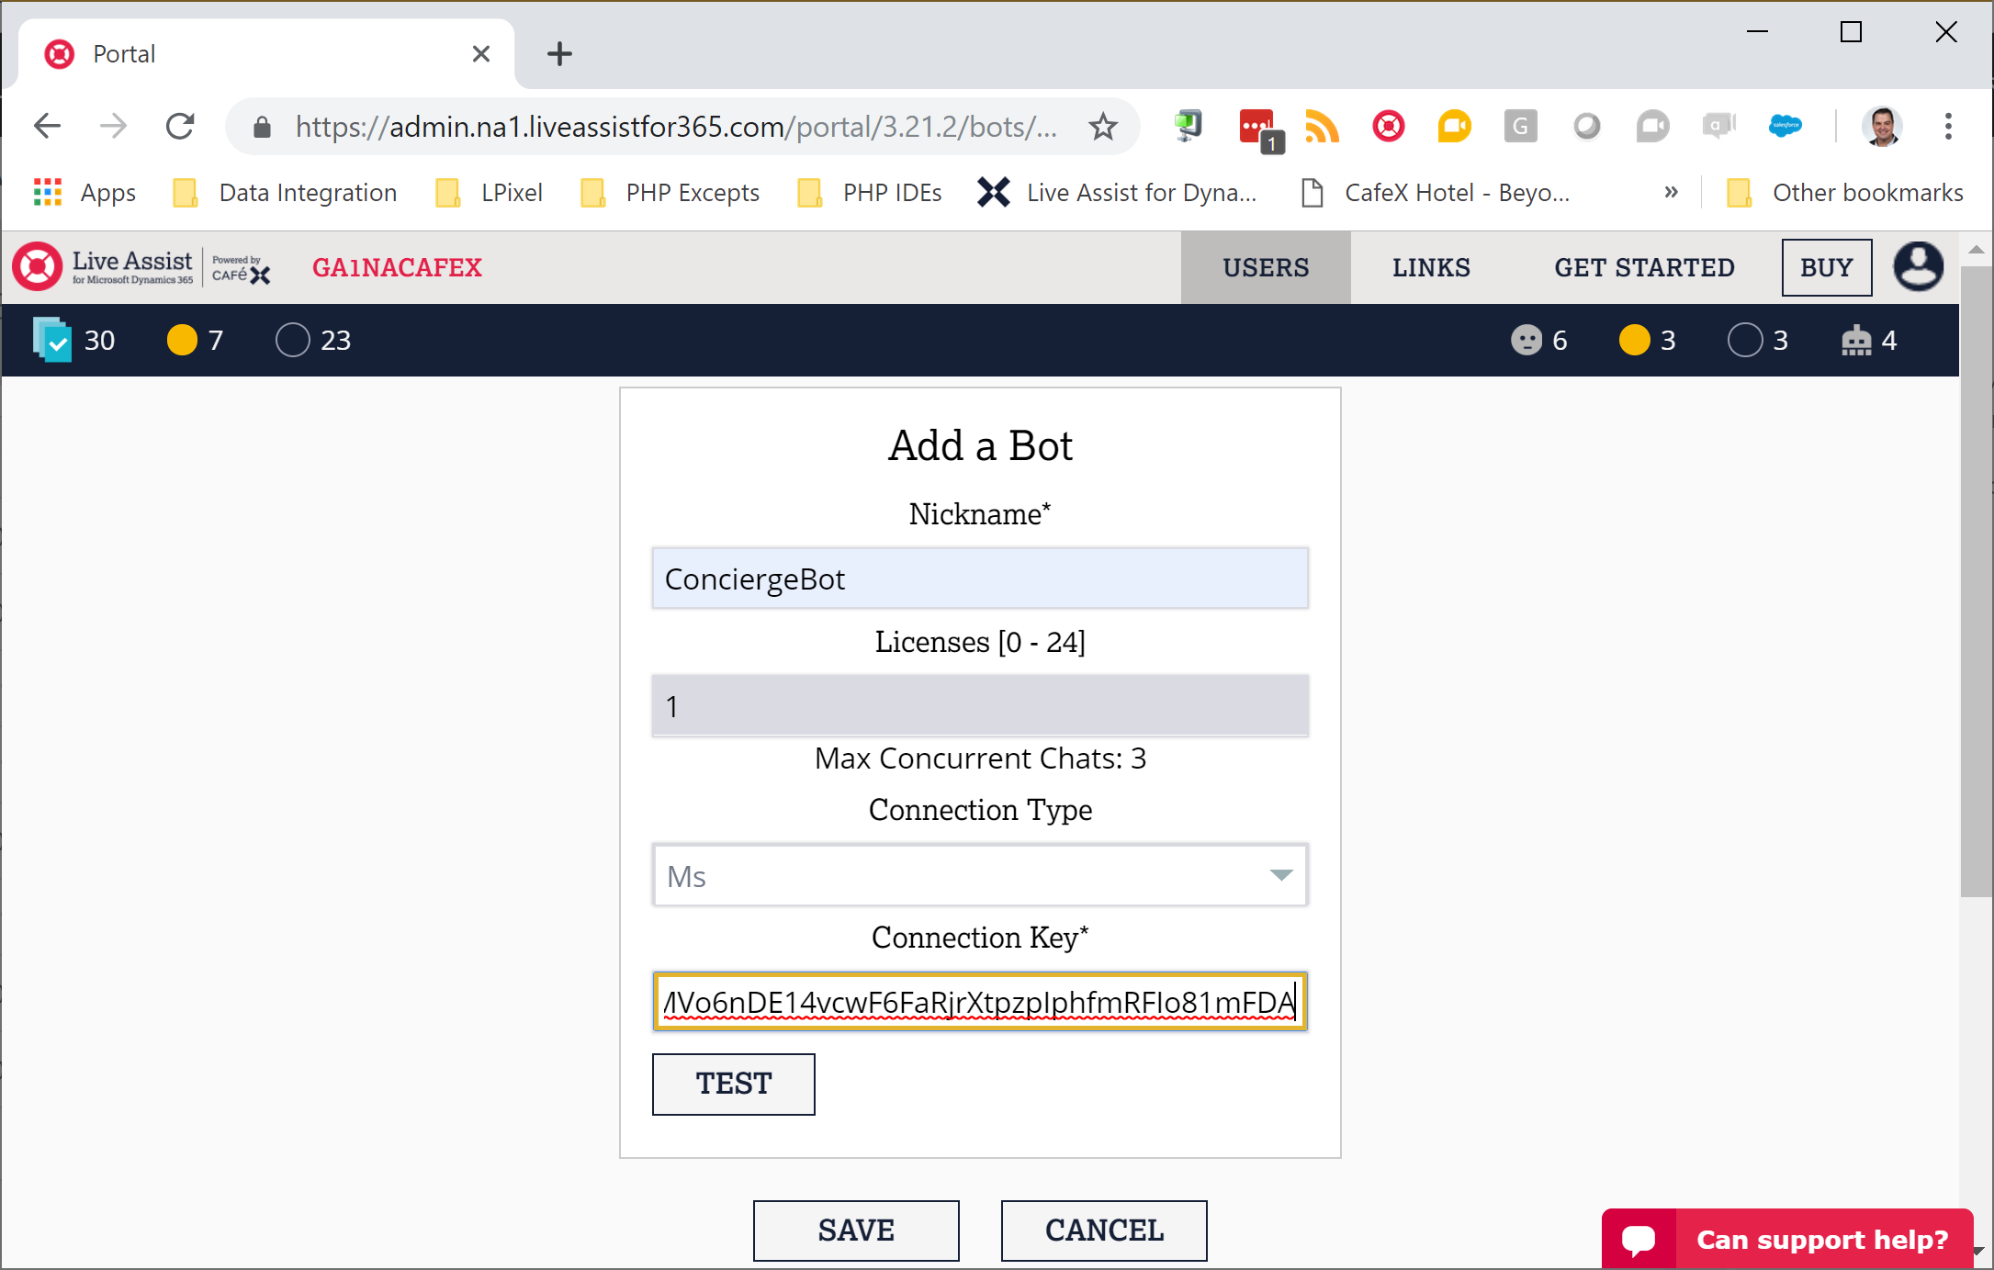
Create a Bot Agent in Live Assist
Chat, talk face-to-face, co-browse and share content simultaneously
No new plugins or downloads for visitors
Embedded call window for agents in Dynamics 365

Slide 26
Embedding Video Conferencing with Ease

Slide 27
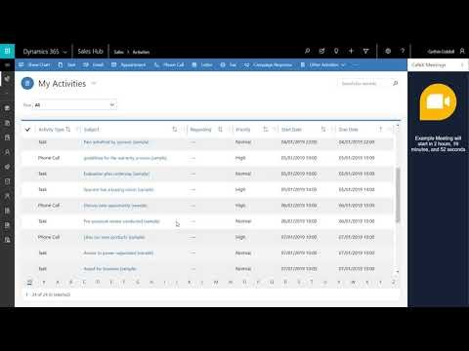
Embedding Conferencing in Dynamics 365
Chat, talk face-to-face, co-browse and share content simultaneously
No new plugins or downloads for visitors
Embedded call window for agents in Dynamics 365

Slide 28
Wrap-Up with Q & A

Slide 29
Key Takeaways
Depth of integration and breadth of features are critical for omnichannel
Adding bots and video doesn’t have to be hard
Start now with a free trial

Slide 30
Suggested Resources
Visit www.cafex.com
Free trial on AppSource (search for ‘Live Assist’)
Live Assist knowledge base
How to enable bots blog article
How to embed meetings support article

Slide 31
Thank you
Todd Lewis
CafeX Communications, tlewis@cafex.com
Please complete your surveys now
www.ugfocus.com/houston-survey

Slide 33
TITLE HEADLINE SECTION
Simple supporting Text Goes Here

Slide 34
ABOUT THIS TEMPLATE
We have assembled this template for your benefit, to make preparation as simple as possible with predefined fonts & colors and different options for content and transition slides.
You can stick with simple text-based slides or get fancier with text + graphics. It’s up to you!
You do not need to use all of the slides from the template. Each slide is there to save you from having to build your own slide layouts.
It also ensures your presentation will have a common look and feel to others being presented at User Group Focus.
Please delete this slide before submitting your deck to the portal.
Thank you for your contribution to User Group Focus and have fun!

Slide 35
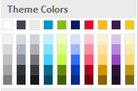
Slide palette info
The PowerPoint palette for this template has been built for you and is shown below. Avoid using too many colors in your presentation.
Use Accent 1 as the main accent color.
Use Accent 2 and Accent 3 when additional colors are needed.
Accent colors 1–6
TEXT
DARK
ACCENT 1
ACCENT 2
ACCENT 3
ACCENT 4
ACCENT 5
ACCENT 6
ACCENT 7

Slide 36
Icons (light)

Slide 37
Icons (light)

Slide 38

Icons (dark)

Slide 39
Icons (dark)

Slide 40
Section title

Slide 41
SECTION TITLE
Main topic 1: size 40pt
Size 20pt for the subtopics
Size 20pt for the subtopics

Slide 42
Text layout (no bullets)
Main topic 1: size 36pt
Size 20pt for the subtopics
Size 20pt for the subtopics
Main topic 2: size 36pt
Size 20pt for the subtopics
Size 20pt for the subtopics

Slide 43
Bullet Points Layout with Subtitle
Subheadline option goes here.
Example of a bulleted slide with a subhead
Set the slide title to “Sentence case”
Set subheads to “Sentence case”
Hyperlink style
www.website.com

Slide 44
Example headline with photo.
Example text point.

Slide 45

Software code slide
This slide layout uses Consolas, a monotype font which is ideal for showing software code.

Slide 46
Lots of data? Minimalize and plan
When a chart or graphic, has more elements than can easily be aligned to the grid, align the outer edges of the group, top, bottom, left and right edges to the grid.
It is preferable to keep the group aligned to the left border.
Gray is used to de-emphasize data that is less important. Use cool gray 3 or cool gray 7. See slide 7 for color formulas.
All elements have the same interior margins as text blocks.
130M
140M
125M
OTHER
OTHER
OTHER
OTHER
OTHER
OTHER

Slide 47
Chart example

Slide 48
Pie chart 2

